Slide 1


Rashmi Lis
10-31-2024

Slide 2

Outline
Executive Summary
Introduction
Methodology
Results
Conclusion
Appendix

Slide 3
Executive Summary
The objective of this project was to analyze SpaceX launch data and build predictive models to determine the likelihood of a successful landing based on various features, such as payload mass, orbit type, and launch site. By employing machine learning algorithms and hyperparameter tuning, we aimed to identify the best model for predicting successful SpaceX landings. The insights gained from this analysis can help improve mission planning and increase the reliability of future launches.
Summary of methodologies/ Summary of all results
In this project, we analyzed SpaceX launch data to predict rocket landing success. We used various models, including Logistic Regression, Support Vector Machine, Decision Tree, and K-Nearest Neighbors, to find the best predictor. The data was prepared by converting text information into numerical form and splitting it into training and test sets. After testing each model, we found one that achieved the highest accuracy in predicting landing outcomes. This model could help SpaceY to improve mission planning and increase landing success rates.
The project tested several models—Logistic Regression, Support Vector Machine, Decision Tree, and K-Nearest Neighbors—to predict successful SpaceX rocket landings. Each model was fine-tuned and evaluated on test data for accuracy. The best-performing model achieved a high accuracy, demonstrating strong reliability in predicting landing outcomes. Analysis with a confusion matrix showed it was effective in distinguishing successful landings from unsuccessful ones. This predictive model can help SpaceX enhance mission planning and improve landing success rates.

Slide 4
Introduction
Project background and context
In this capstone, we predicted if the Falcon 9 first stage will land successfully. SpaceX advertises Falcon 9 rocket launches on its website, with a cost of 62 million dollars; other providers cost upward of 165 million dollars each, much of the savings is because SpaceX can reuse the first stage.
Problems you want to find answers
Can we determine if the first stage will land?
Can we can determine the cost of a launch?
This information can be used if an alternate company wants to bid against SpaceX for a rocket launch

Slide 5

Section 1

Slide 6
Methodology
Executive Summary
Data collection methodology:
Describe how data was collected
Perform data wrangling
Describe how data was processed
Perform exploratory data analysis (EDA) using visualization and SQL
Perform interactive visual analytics using Folium and Plotly Dash
Perform predictive analysis using classification models
How to build, tune, evaluate classification models

Slide 7
Data Collection
The data used for this project was sourced from a public SpaceX dataset, which includes details about each rocket launch. The dataset contains various attributes such as payload mass, orbit type, launch site, and landing outcome (success or failure).The data was collected from reliable online sources, which recorded historical data for SpaceX launches, covering both successful and unsuccessful missions.

Slide 8
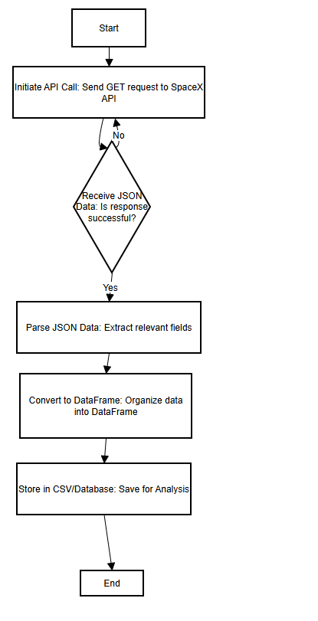
Data Collection – SpaceX API
Github API Calls: jupyter-labs-eda-sql-coursera_sqllite.ipynb

Slide 9
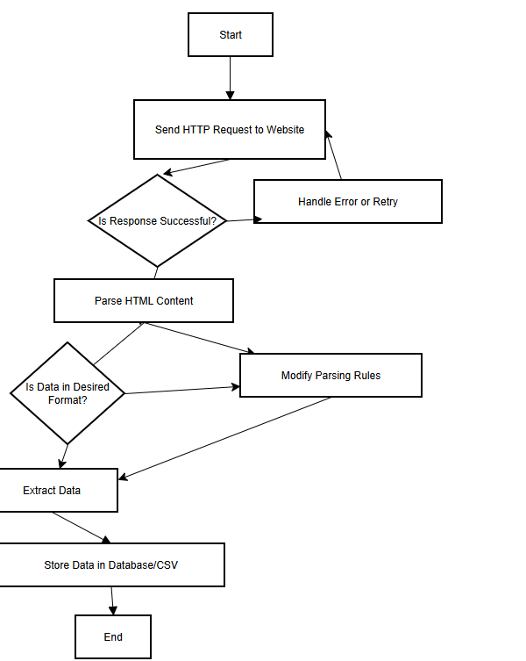
Data Collection - Scraping
Github API Calls: DatascienceCapstoneSpaceX/jupyter-labs-eda-sql-coursera_sqllite.ipynb at main · rlis123456/DatascienceCapstoneSpaceX (github.com)

Slide 10
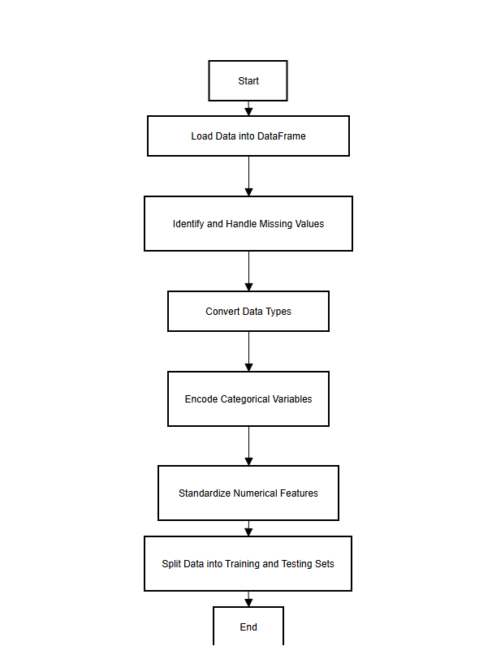
Data Wrangling
Data processing starts with loading the data from various sources into a DataFrame for easy manipulation. Missing values are then handled by either filling them (using methods like mean or median imputation) or dropping rows/columns if needed. Next, data types are converted for consistency, and categorical variables are encoded into numerical formats suitable for modeling. Finally, numerical features are standardized, and the data is split into training and testing sets to evaluate model performance on new data.
GitHub URL: DatascienceCapstoneSpaceX/labs-jupyter-spacex-Data wrangling-v2.ipynb at main · rlis123456/DatascienceCapstoneSpaceX (github.com)

Slide 11
EDA with Data Visualization
To summarize the charts used in the Exploratory Data Analysis (EDA):Bar Charts: Used to display the distribution of categorical variables like launch sites and orbit types, allowing us to see the frequency of launches across different categories.Line Charts: Plotted over time to observe trends, such as changes in launch success rates over the years, helping to identify any patterns or improvements.Scatter Plots: Employed to examine relationships between numerical variables, such as payload mass and success rates, providing insights into how payload size may influence landing outcomes.Heatmaps: Used to show correlations between variables, helping to understand how different features (like payload mass and launch site) may relate to each other and impact launch success.Each chart type was chosen to provide clear visual insights into different aspects of the data, making it easier to identify patterns and relationships that are crucial for predictive modeling.
GitHub URL DatascienceCapstoneSpaceX/jupyter-labs-eda-dataviz-v2.ipynb at main · rlis123456/DatascienceCapstoneSpaceX (github.com)

Slide 12
EDA with SQL
Retrieve and Filter Launch Data: Queried unique launch sites, filtered launches by specific site prefixes, and identified payloads by customer to analyze launch distribution and payload trends.
Calculate Payload Metrics: Calculated total and average payload mass for specific booster versions to assess their load-handling capacity.
Identify Key Dates and Events: Found the earliest successful landing date and filtered records by payload mass range and success criteria to highlight important milestones.
Analyze Mission Outcomes: Counted successful vs. failed missions, ranked landing outcomes, and examined failed landings by month to understand success rates and identify patterns.
GitHub URL DatascienceCapstoneSpaceX/jupyter-labs-eda-sql-coursera_sqllite.ipynb at main · rlis123456/DatascienceCapstoneSpaceX (github.com)

Slide 13
Build an Interactive Map with Folium
Markers: Placed markers at each launch site to indicate the exact locations of SpaceX launches. These markers help viewers identify and differentiate each launch site's geographic position on the map.
Circles: Added circle markers with color-coded radii around key points, like the closest coastline or populated areas near launch sites. This visualizes proximity, showing how close these points are to the launch sites, which may affect launch safety or logistical planning.
Lines: Drew lines connecting launch sites to significant nearby locations, such as the closest coastline or nearby cities. These lines highlight the distance from the launch site to these points of interest, providing context for logistical or safety considerations.
Popup Labels: Included popup information on markers to display details like the launch site's name, success rate, or other key statistics. These provide additional context to users, allowing them to view essential data without needing to leave the map.Explain why you added those objects
GitHub URL DatascienceCapstoneSpaceX/lab-jupyter-launch-site-location-v2.ipynb at main · rlis123456/DatascienceCapstoneSpaceX (github.com)

Slide 14
Build a Dashboard with Plotly Dash
In the dashboard, several interactive plots and visualizations were added to facilitate data exploration. Firstly, a pie chart was included to illustrate the success rates of SpaceX launches across different sites, which allows users to understand which sites have the most successful launches. This chart is interactive, with a dropdown menu for selecting specific launch sites to get targeted insights. Secondly, a scatter plot was created to show the relationship between payload mass and launch outcome, with the ability to filter by payload range and color-coded by booster version, enabling users to observe any correlation between payload and success rate.
These plots and interactions were added to make the dashboard informative and user-friendly, allowing users to explore various factors that may affect launch success, such as launch site and payload mass. The interactivity, specifically through dropdowns and sliders, provides flexibility in data analysis, making it easy to draw insights based on selected parameters.
GitHub URL: DatascienceCapstoneSpaceX/DashApp.ipynb at main · rlis123456/DatascienceCapstoneSpaceX (github.com)

Slide 15
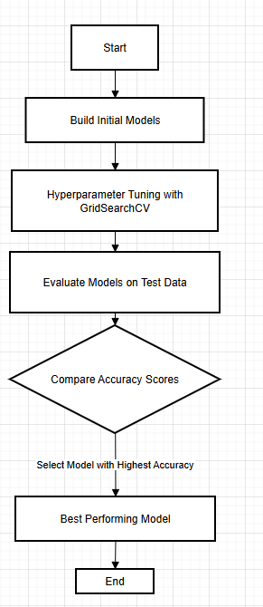
Predictive Analysis (Classification)
Model Building: We started by creating different classification models, including Logistic Regression, Support Vector Machine (SVM), Decision Tree, and K-Nearest Neighbors (KNN). These models were chosen to compare their effectiveness at predicting the target variable.
Hyperparameter Tuning: For each model, we used GridSearchCV to find the best parameters, such as C and kernel for SVM and max_depth for Decision Trees. This tuning process optimized model performance by adjusting key parameters to their best values based on cross-validation.
Model Evaluation: After tuning, each model was evaluated on test data using accuracy scores to assess performance. Confusion matrices were also used to understand how well each model classified the data into correct categories.
Selecting the Best Model: The model with the highest accuracy score on the test data was selected as the best-performing model. This approach ensured that the chosen model had the best predictive ability for new, unseen data.
GitHub URLDatascienceCapstoneSpaceX/SpaceX-Machine-Learning-Prediction-Part-5-v1.ipynb at main · rlis123456/DatascienceCapstoneSpaceX (github.com)

Slide 16
Results
Exploratory data analysis results
In the EDA phase, we visualized the data to understand distributions, patterns, and relationships between key variables. Bar charts were used to examine launch frequencies by site and mission success rates, while scatter plots explored relationships like payload mass versus launch outcome. We also used heatmaps to analyze correlations between different features, helping identify factors that may influence mission outcomes.
Interactive analytics demo in screenshots
The interactive analytics component, demonstrated using screenshots, includes tools like Folium maps and Plotly dashboards. Folium maps displayed geographic data, showing launch site locations, nearby coastlines, and cities. The Plotly dashboard enabled interactive filtering and exploration of launch success rates by site and year, making it easy for users to drill down into specific data points and trends.
Predictive analysis results
In the predictive analysis phase, we built several classification models (Logistic Regression, SVM, Decision Tree, and KNN) to predict launch outcomes. After hyperparameter tuning and evaluation, the model with the highest accuracy score was selected as the best performer. This model provides reliable predictions on launch success, potentially aiding SpaceX in future mission planning and operational adjustments.

Slide 17

Section 2

Slide 18
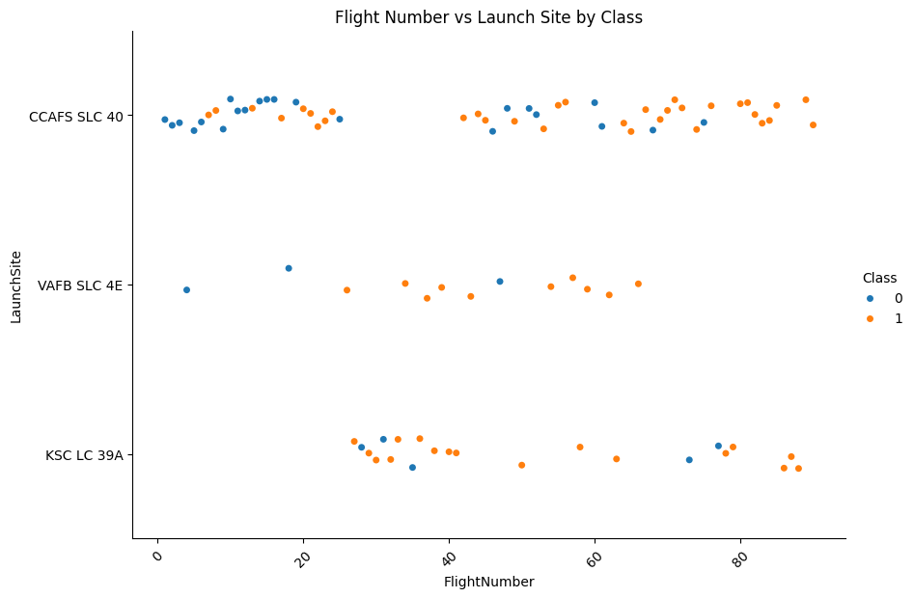
Flight Number vs. Launch Site
From the plot, we can observe:
At CCAFS SLC 40, a larger number of launches were conducted, with a trend toward more successful launches over time, as shown by the increase in orange points with higher flight numbers.
KSC LC 39A has a mix of successes and failures early on, but recent launches appear more successful.
VAFB SLC 4E shows fewer launches overall, with a balanced distribution of successes and failures.

Slide 19
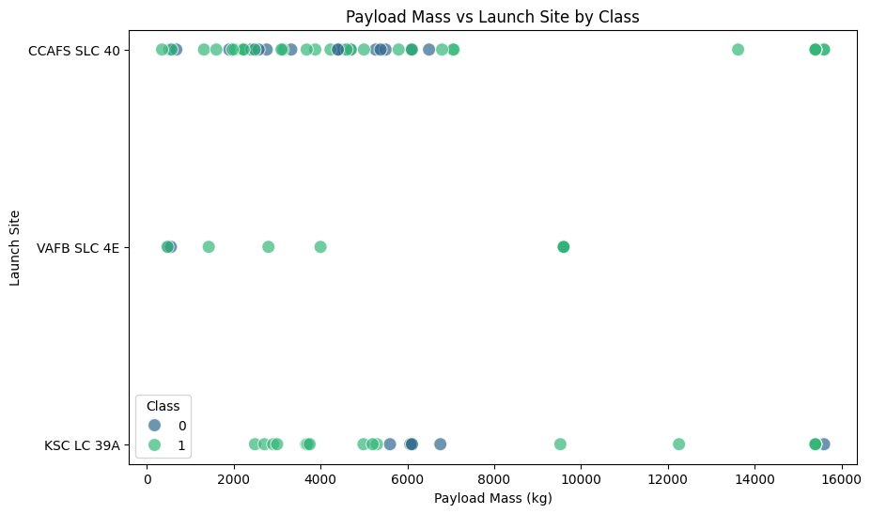
Payload vs. Launch Site
This plot suggests that CCAFS SLC 40 is a versatile launch site, handling a wide range of payloads with a high success rate. KSC LC 39A appears to handle high payloads with a higher success rate, while VAFB SLC 4E is more limited in terms of payload capacity. This visualization supports the idea that payload mass and launch site may influence mission success, with certain sites better suited for heavier payloads.

Slide 20
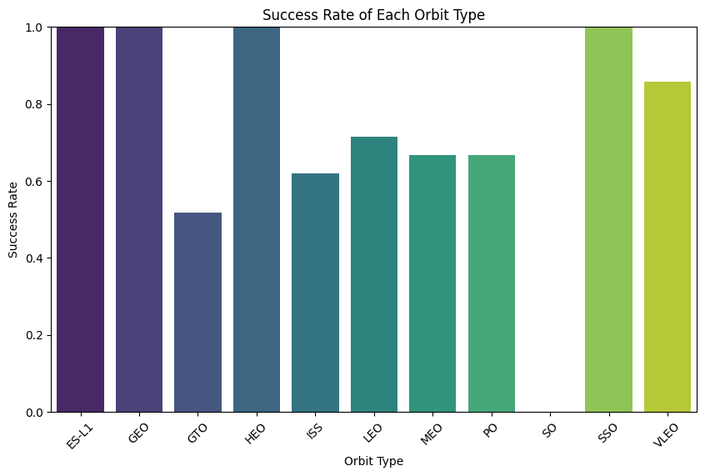
Success Rate vs. Orbit Type
This analysis reveals that SpaceX has a high success rate for missions to certain orbits (e.g., ES-L1, GEO, SSO), which could be due to standardization or less demanding trajectories. The lower success rate for GTO may indicate higher risks or complexity associated with these missions. Overall, the chart helps identify which orbit types are associated with greater reliability, providing insights into SpaceX’s mission planning and operational focus.

Slide 21
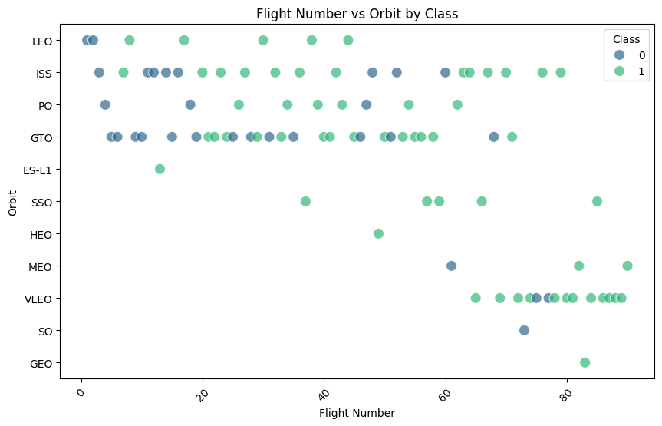
Flight Number vs. Orbit Type
The plot reveals that SpaceX's success rate improves with experience, particularly in common orbits like LEO, ISS, and GTO. This trend could reflect the company’s learning curve and advancements in technology and operational processes. The success rates across different orbit types suggest that while some orbits pose more challenges (like GTO), SpaceX has achieved reliability in others over time, especially in low and medium Earth orbits. This analysis highlights SpaceX's evolving reliability and capability to handle various mission requirements.

Slide 22
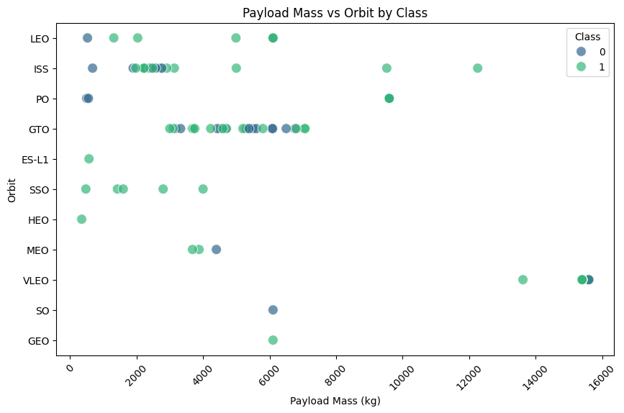
Payload vs. Orbit Type
The plot reveals that SpaceX's success rate improves with experience, particularly in common orbits like LEO, ISS, and GTO. This trend could reflect the company’s learning curve and advancements in technology and operational processes. The success rates across different orbit types suggest that while some orbits pose more challenges (like GTO), SpaceX has achieved reliability in others over time, especially in low and medium Earth orbits. This analysis highlights SpaceX's evolving reliability and capability to handle various mission requirements.

Slide 23
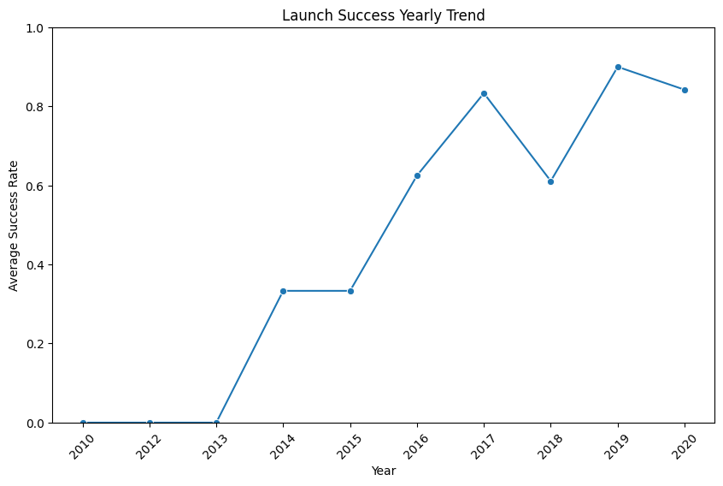
Launch Success Yearly Trend
This trend highlights SpaceX’s rapid progress in increasing launch reliability, especially from 2015 onward. The continuous improvement reflects the company’s commitment to overcoming initial setbacks and advancing its technology, positioning itself as a leader in the aerospace industry with increasingly successful missions over the decade.

Slide 24
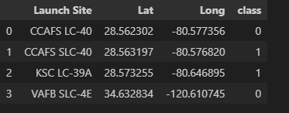
All Launch Site Names
The query results display a summary of each SpaceX launch site with its respective latitude and longitude coordinates, alongside a class indicator for mission success. Here’s a breakdown of the output:
Launch Site: Indicates the name of each SpaceX launch site.
Lat (Latitude) and Long (Longitude): Provide geographic coordinates for each launch site, showing their precise location.
Class: Denotes the mission outcome where 0 indicates an unsuccessful mission (failure to land), and 1 indicates a successful mission (landed).

Slide 25
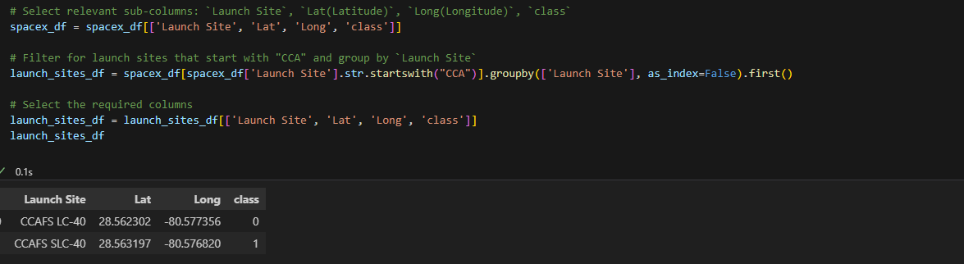
Launch Site Names Begin with 'CCA'
This code filters the data to include only launch sites whose names begin with "CCA" and then groups them to get unique entries with the specified columns. The output will show only those launch sites starting with "CCA" along with their latitude, longitude, and a sample mission outcome.

Slide 26
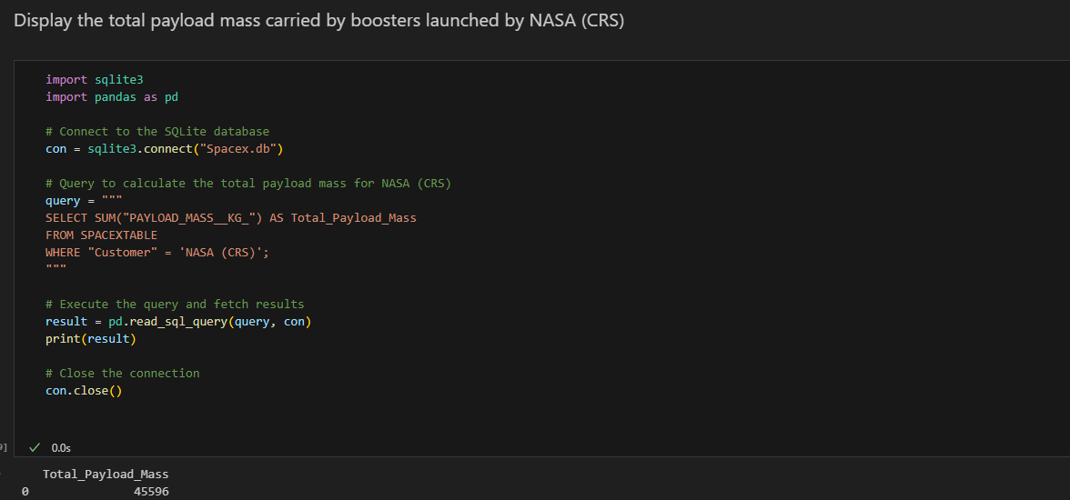
Total Payload Mass

Slide 27
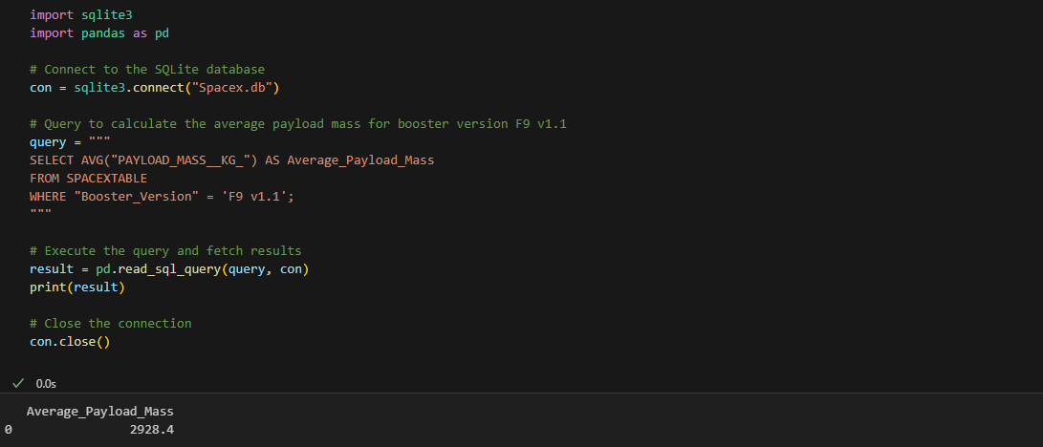
Average Payload Mass by F9 v1.1

Slide 28
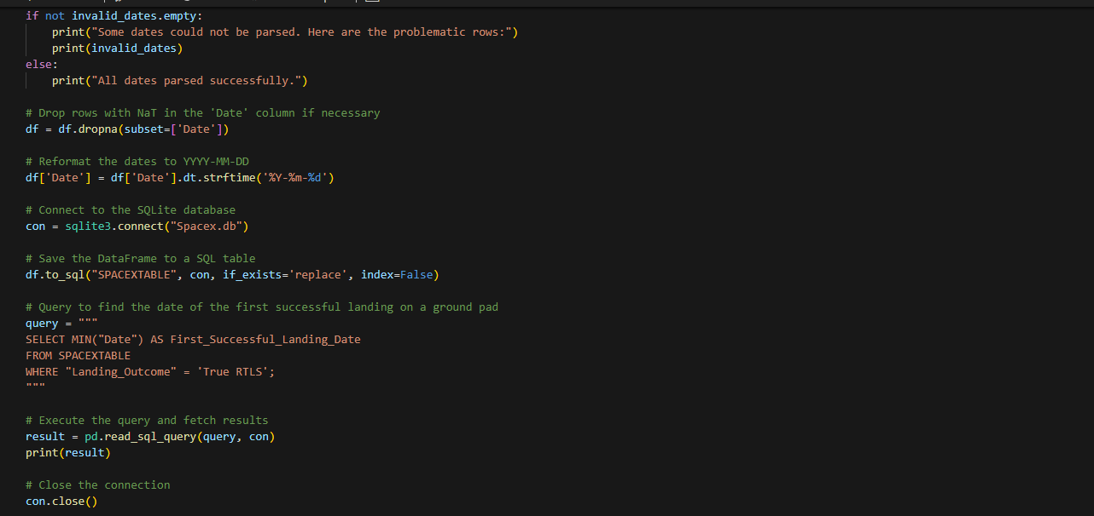
First Successful Ground Landing Date
04-06-2010

Slide 29
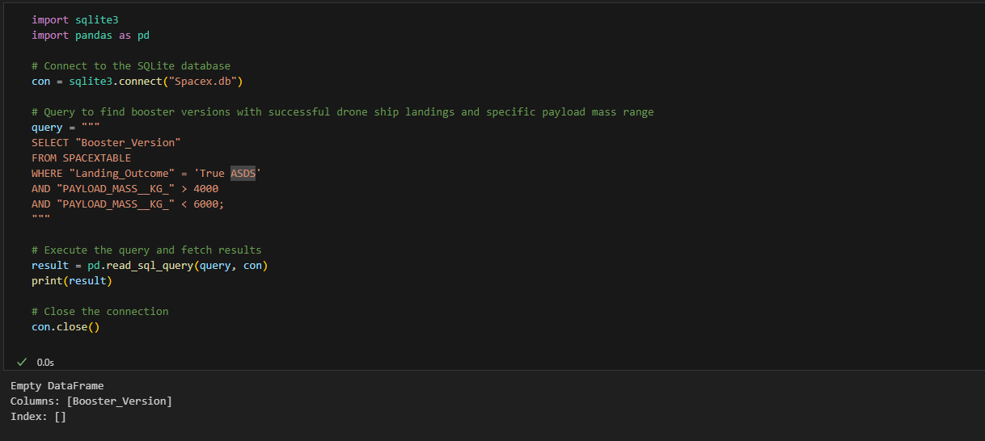
Successful Drone Ship Landing with Payload between 4000 and 6000

Slide 30
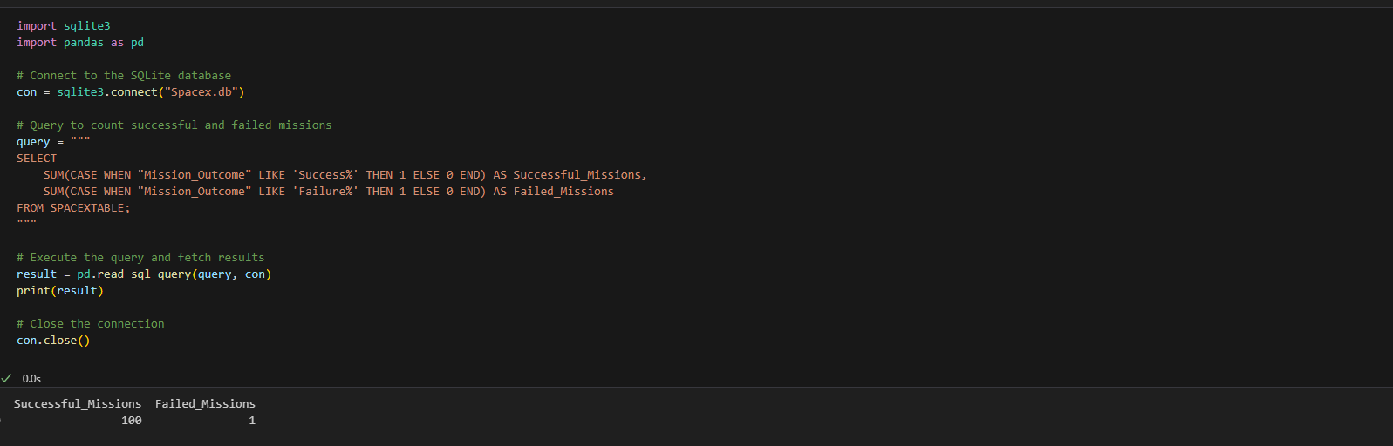
Total Number of Successful and Failure Mission Outcomes

Slide 31
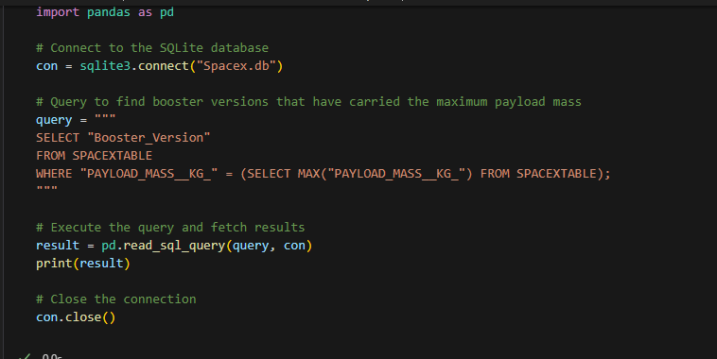
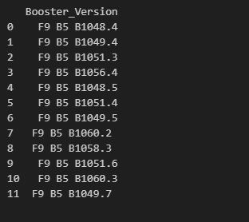
Boosters Carried Maximum Payload

Slide 32
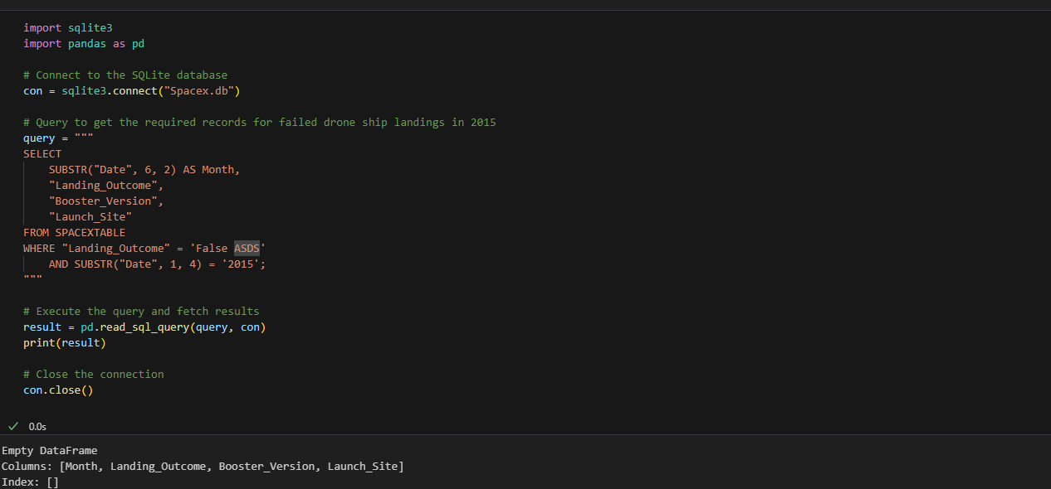
2015 Launch Records

Slide 33
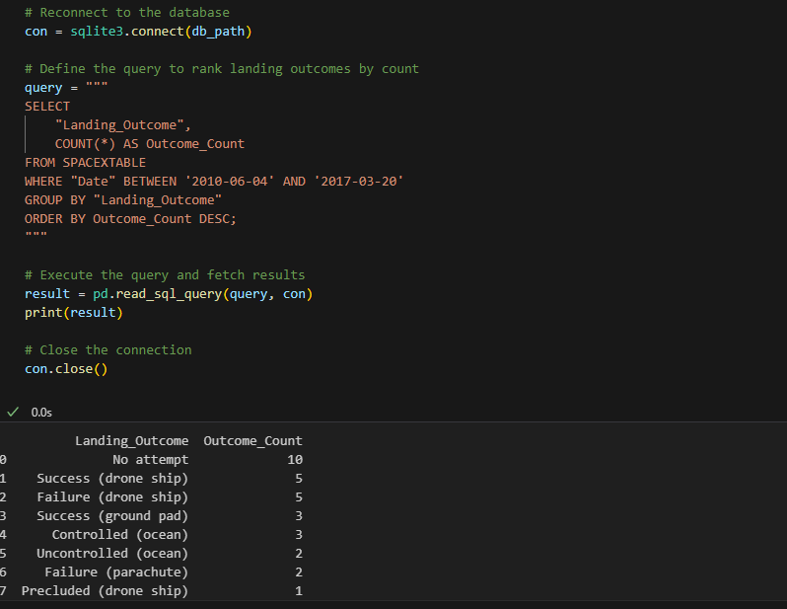
Rank Landing Outcomes Between 2010-06-04 and 2017-03-20

Slide 34

Section 3

Slide 35
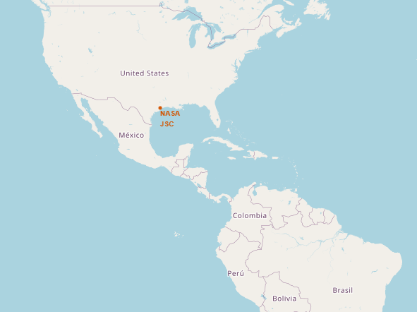
NASA Johnson Space Center's coordinate
This code highlights NASA Johnson Space Center on the map with an orange-filled circle and a labeled marker, providing a clear visual cue and textual information about the location. Users can interact with the circle to see additional information in the popup.

Slide 36
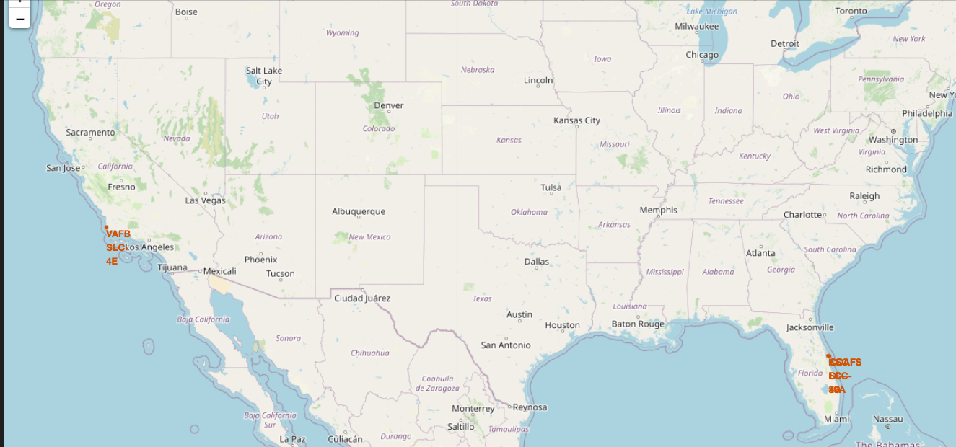
Circle and Marker
This map displays key SpaceX launch and landing sites across the United States. Each site is marked with a location label, showing the coordinates of the following sites:
VAFB SLC-4E: Located in California, the Vandenberg Air Force Base (Space Launch Complex 4 East) appears in the southwestern region. This is a significant site for polar launches and other orbits that benefit from a west coast location.
CCAFS BOC and LC-39A: Situated on the eastern coast of Florida, near Cape Canaveral, these labels refer to the Cape Canaveral Air Force Station (CCAFS) and Kennedy Space Center's Launch Complex 39A (LC-39A). These locations are crucial for launches that benefit from proximity to the equator, providing efficient trajectories for geostationary orbits and other mission profiles.
Each site has a clear label positioned with bright orange text, enhancing visibility. The layout effectively conveys geographic distinctions, showing the concentration of launch facilities on the coasts, with Florida and California serving as SpaceX's primary launch and landing points. This map could be helpful for users interested in understanding SpaceX's strategic locations within the United States, demonstrating the geographic spread that supports a range of orbital missions.

Slide 37
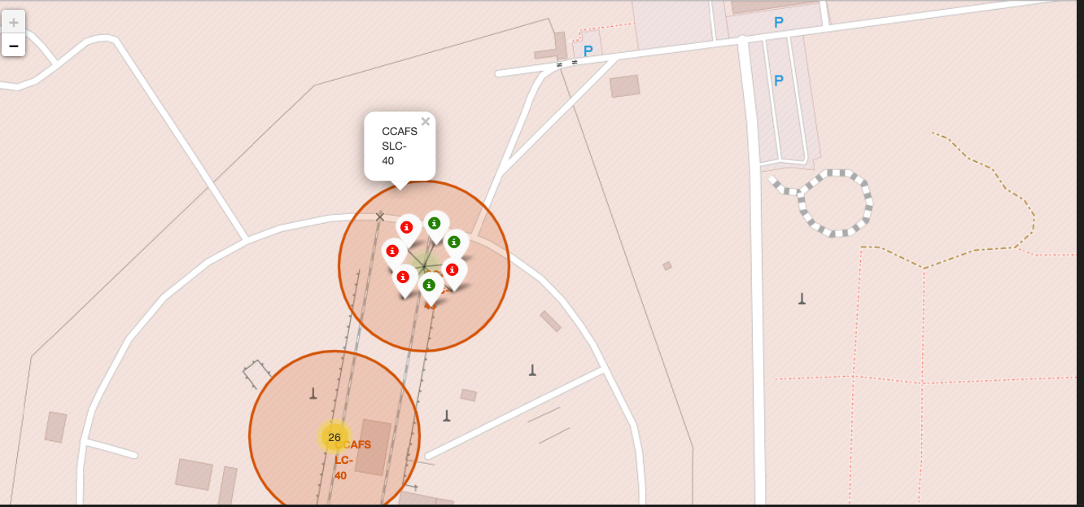
Proximity
This detailed map view focuses on Cape Canaveral Air Force Station's Launch Complex 40 (CCAFS SLC-40), which is one of SpaceX's primary launch sites. The markers and icons provide specific information:
Cluster of Markers: The markers with red and green icons seem to represent different launch outcomes or statuses, potentially differentiating successful and unsuccessful launches. Green markers typically denote successful landings or missions, while red markers may represent unsuccessful attempts. This clustering could indicate multiple events associated with this location.
Overlapping Circles: The orange circles likely represent zones of interest or range areas around the launch site, highlighting its boundaries or operational zones.
Popup Label: The popup label "CCAFS SLC-40" provides quick reference to the launch site's name, which is helpful for users to identify the specific complex.
Nearby Facilities and Roads: The surrounding structures, roads, and parking areas (labeled "P") reflect the infrastructure surrounding the launch complex, indicating its accessibility and the presence of supporting facilities.
This detailed mapping and use of markers provide insights into the activities and historical events at CCAFS SLC-40, allowing users to understand the site's operational history visually. It’s a valuable layout for tracking launch outcomes at this specific SpaceX launch site.

Slide 38

Section 4

Slide 39
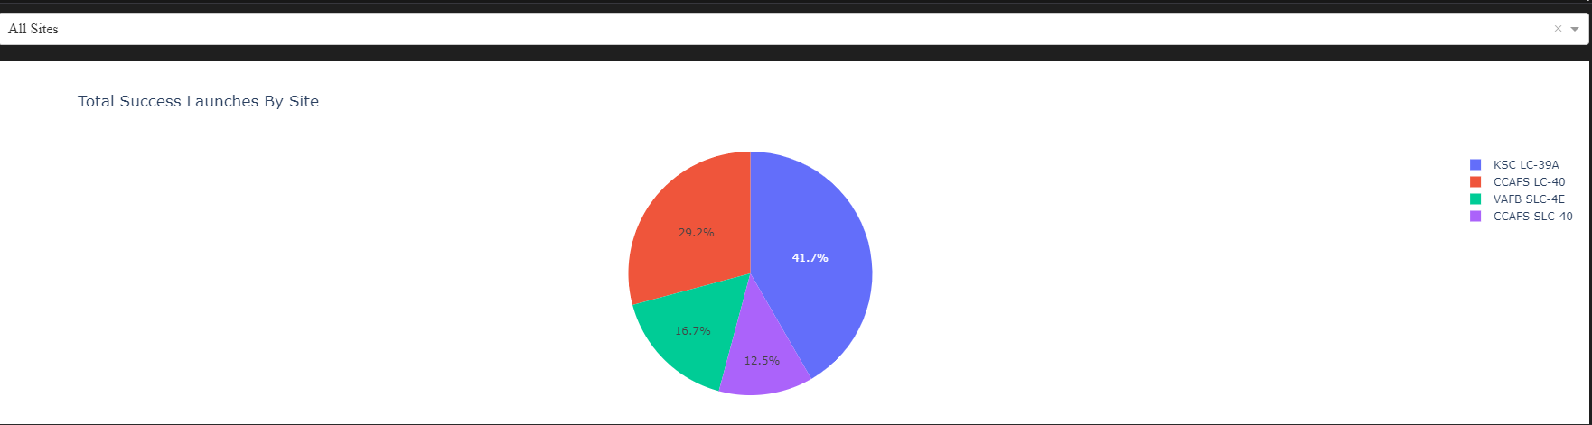
Launch Success Count
This pie chart illustrates the distribution of successful SpaceX launches across different launch sites. The majority of successful launches occurred at the KSC LC-39A site, accounting for 41.7% of the total, indicating it is the most frequently used or perhaps most reliable site for successful launches. Following KSC LC-39A, CCAFS LC-40 holds 29.2% of successful launches, suggesting it is also a significant site but with a slightly lower success count. VAFB SLC-4E and CCAFS SLC-40 show lower success rates, with 16.7% and 12.5% respectively, which might indicate less frequent usage or lower reliability for these specific missions.
These insights help highlight KSC LC-39A as a key site for successful launches and may guide decision-making for future launch planning, particularly if the goal is to maximize mission success.

Slide 40
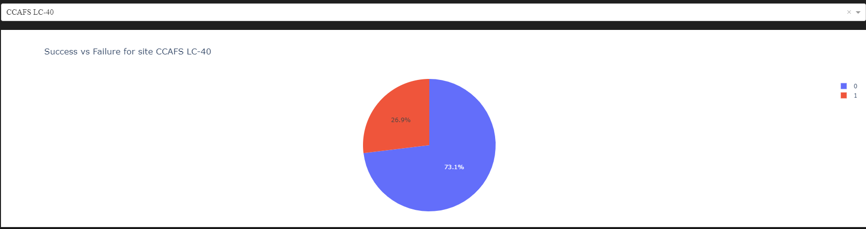
Highest Launch Success Ratio Site
This pie chart shows the success versus failure rate for launches at the CCAFS LC-40 site. The data indicates a 73.1% success rate, while 26.9% of launches at this site resulted in failure. This high success rate suggests that CCAFS LC-40 has generally reliable outcomes, though there remains a notable proportion of failed launches. This information can be valuable for assessing the reliability of this specific site in future launch decisions.

Slide 41
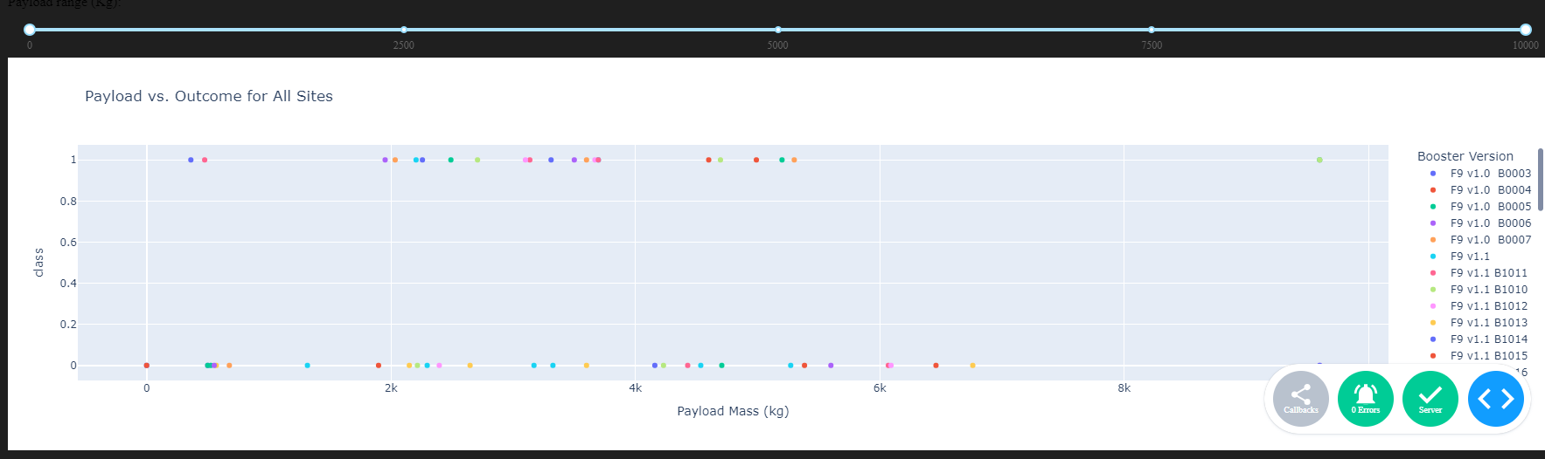
Payload vs. Launch Outcome for all sites
This scatter plot visualizes the relationship between payload mass (x-axis) and launch outcome (y-axis) across all launch sites. Each point represents a launch, with the payload mass shown along the x-axis, the success (1) or failure (0) of the launch on the y-axis, and the color indicating the booster version used. The spread of points suggests that launches with varying payload masses have different outcomes, but there is no clear trend in payload mass affecting success rates directly, as both successful and unsuccessful outcomes appear across payload ranges. The color differentiation for booster versions provides insight into which versions correlate more with successful launches, enabling analysis of performance across different booster models.

Slide 42

Section 5

Slide 43
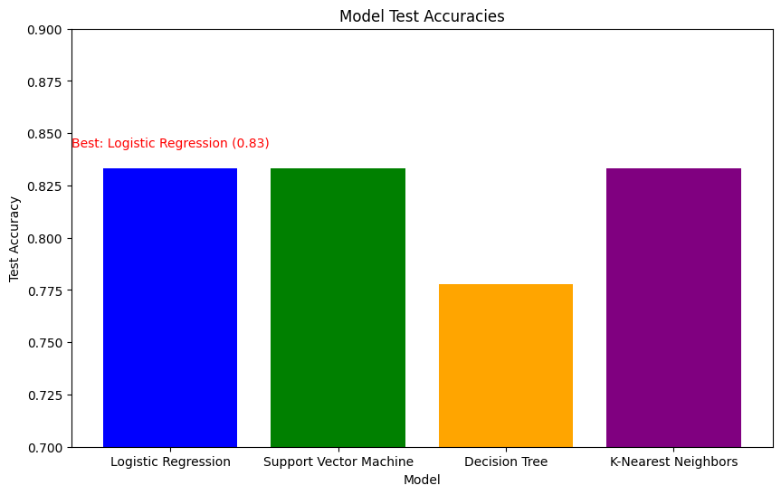
Classification Accuracy

Slide 44

Confusion Matrix

Slide 45
Conclusions
Predicting First Stage Landing: Through our machine learning analysis, we found that logistic regression, support vector machines, and k-nearest neighbors achieved around 83% accuracy in predicting whether the first stage would land successfully. This indicates a strong potential for using historical data to predict landing outcomes, helping SpaceX or competitors anticipate the likelihood of success.
Estimating Launch Costs: Although our analysis focused on launch success, certain factors we explored, like payload mass and launch site, can be indicators of cost. Additional features such as mission complexity, customer requirements, and specific cost data could be incorporated in future models to better estimate launch costs. A detailed cost analysis can provide a competitive advantage for companies bidding against SpaceX.
Competitive Bidding Insights: The insights from our exploratory analysis and machine learning results could aid alternate companies by identifying factors that contribute to successful missions. Competitors could optimize their launch bids by understanding conditions that maximize landing success, which in turn lowers costs through reusability.
Future Applications: By expanding the dataset to include more detailed cost-related variables, alternate companies can use similar predictive models to simulate scenarios and propose competitive bids. The use of machine learning could enable more precise predictions of costs and outcomes, creating a strategic advantage in the space industry.

Slide 46
Appendix
All files are located in gitbub: https://github.com/rlis123456/DatascienceCapstoneSpaceX/

Slide 47


